Slide 1
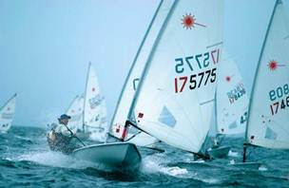
PPD Finances
Resource+Capital
SLA £140k Overspend wrt OTF £164k Underspend wrt Allocation
PPD only £11k Underspend wrt OTF £74k Underspend wrt Allocation
TOTAL (PPD+SLA) £129k Overspend wrt OTF £238k Underspend wrt Allocation
Why the PPD Underspend wrt Allocation ?
Puzzling – we may be missing something in understanding.
There are several different cost centres involved and a fair amount of attempting to balance the books across these, which complicates things.
Then there is the age-old problem of only getting reliable info for our spend as we approach the End of FY, and then it gets tricky to increase spend (witness our efforts with Buy-up).
In particular the Indirects spending was puzzling – we appeared to be heading for a massive underspend there and all of a sudden this shot up.
Another common problem is people have an allocation of money and it is only retrospectively (not aided by the difficulty of tracking travel in OBIEE) that we appreciate they never used the money.
The biggest issue was our manpower slipping below target. This was due to me not appreciating that some people were not booking, not aided by the fact that I hadn’t been forewarned of issues affecting certain posts.

Slide 2
PPD Finances
Just SLA (Experiments) – wrt OTF (no OHeads)
nEDM Bang on
T2K £69k Over
LHCb £29k Under
LBNE £14k Under
HK £11k Over
CMS £34k Over
ATLAS £40k Over
Grid £42k Over
Mice £43k Over
Pretty good ☺.
PPD should come in “under the radar”.

Slide 3


Open Day
About 50 shifts.
So far, have ~38 filled ☺ (assuming some TBCs confirm).
We have ~12 more Particle Physicists and Applied Physicists who could participate ☺

